Slide 1
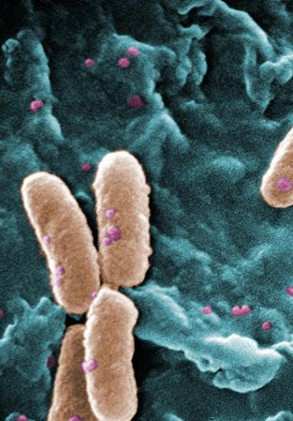
Collaboration with Open-source Antibiotics/murligase SSGCID update
cSMRT
Jan Abendroth
8 February 2022

Slide 2
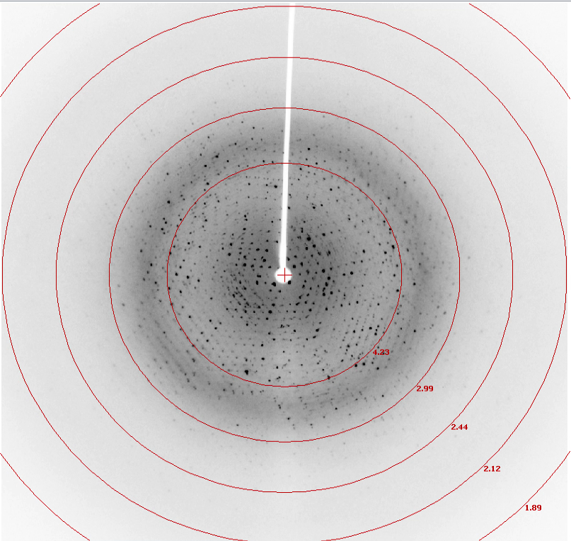
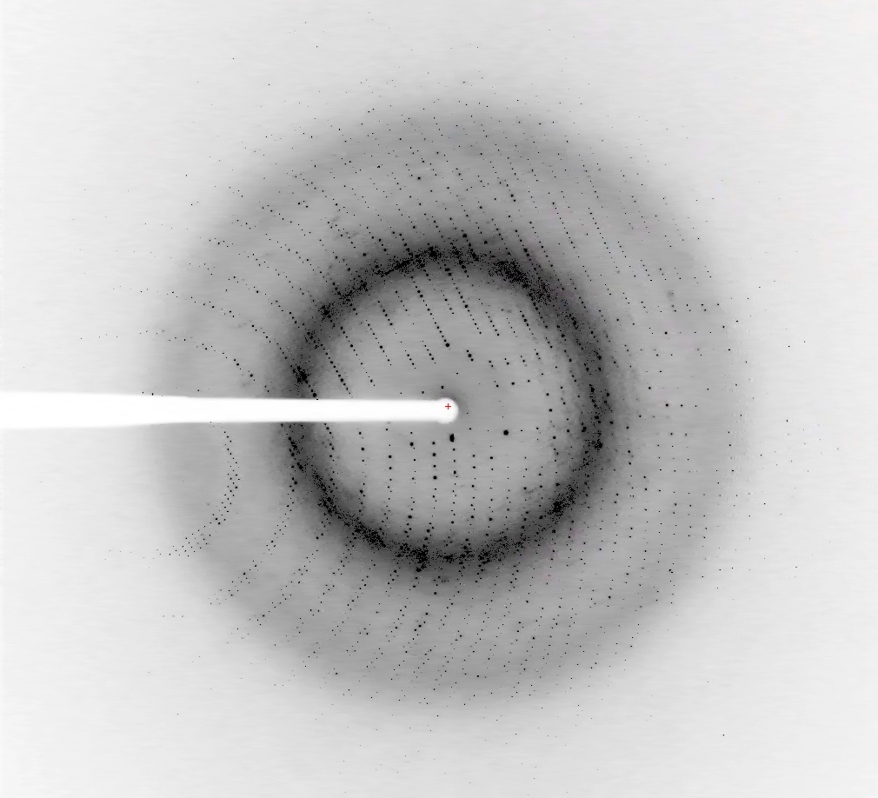
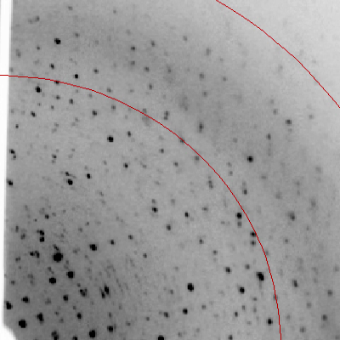
P. aeruginosa, MurD + ADP, PsaeA.17938.a.B2
Status:
noisy diffraction, still OK-ish 2.15Å data set
structure solves and refines well, ADP density clear
working on optimized crystals
Res: 50-2.15Å
R_{sym}: 0.108 (0.626)
I/sigI: 11.5 (3.2)
PsaeA.17938.a.B2 + ADP diffraction
AcbaC.17938.a.B1 + ADP diffraction

Slide 3
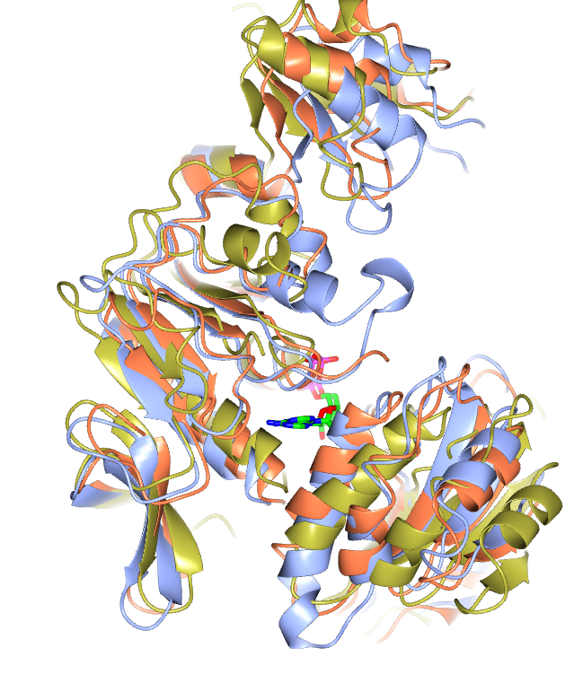
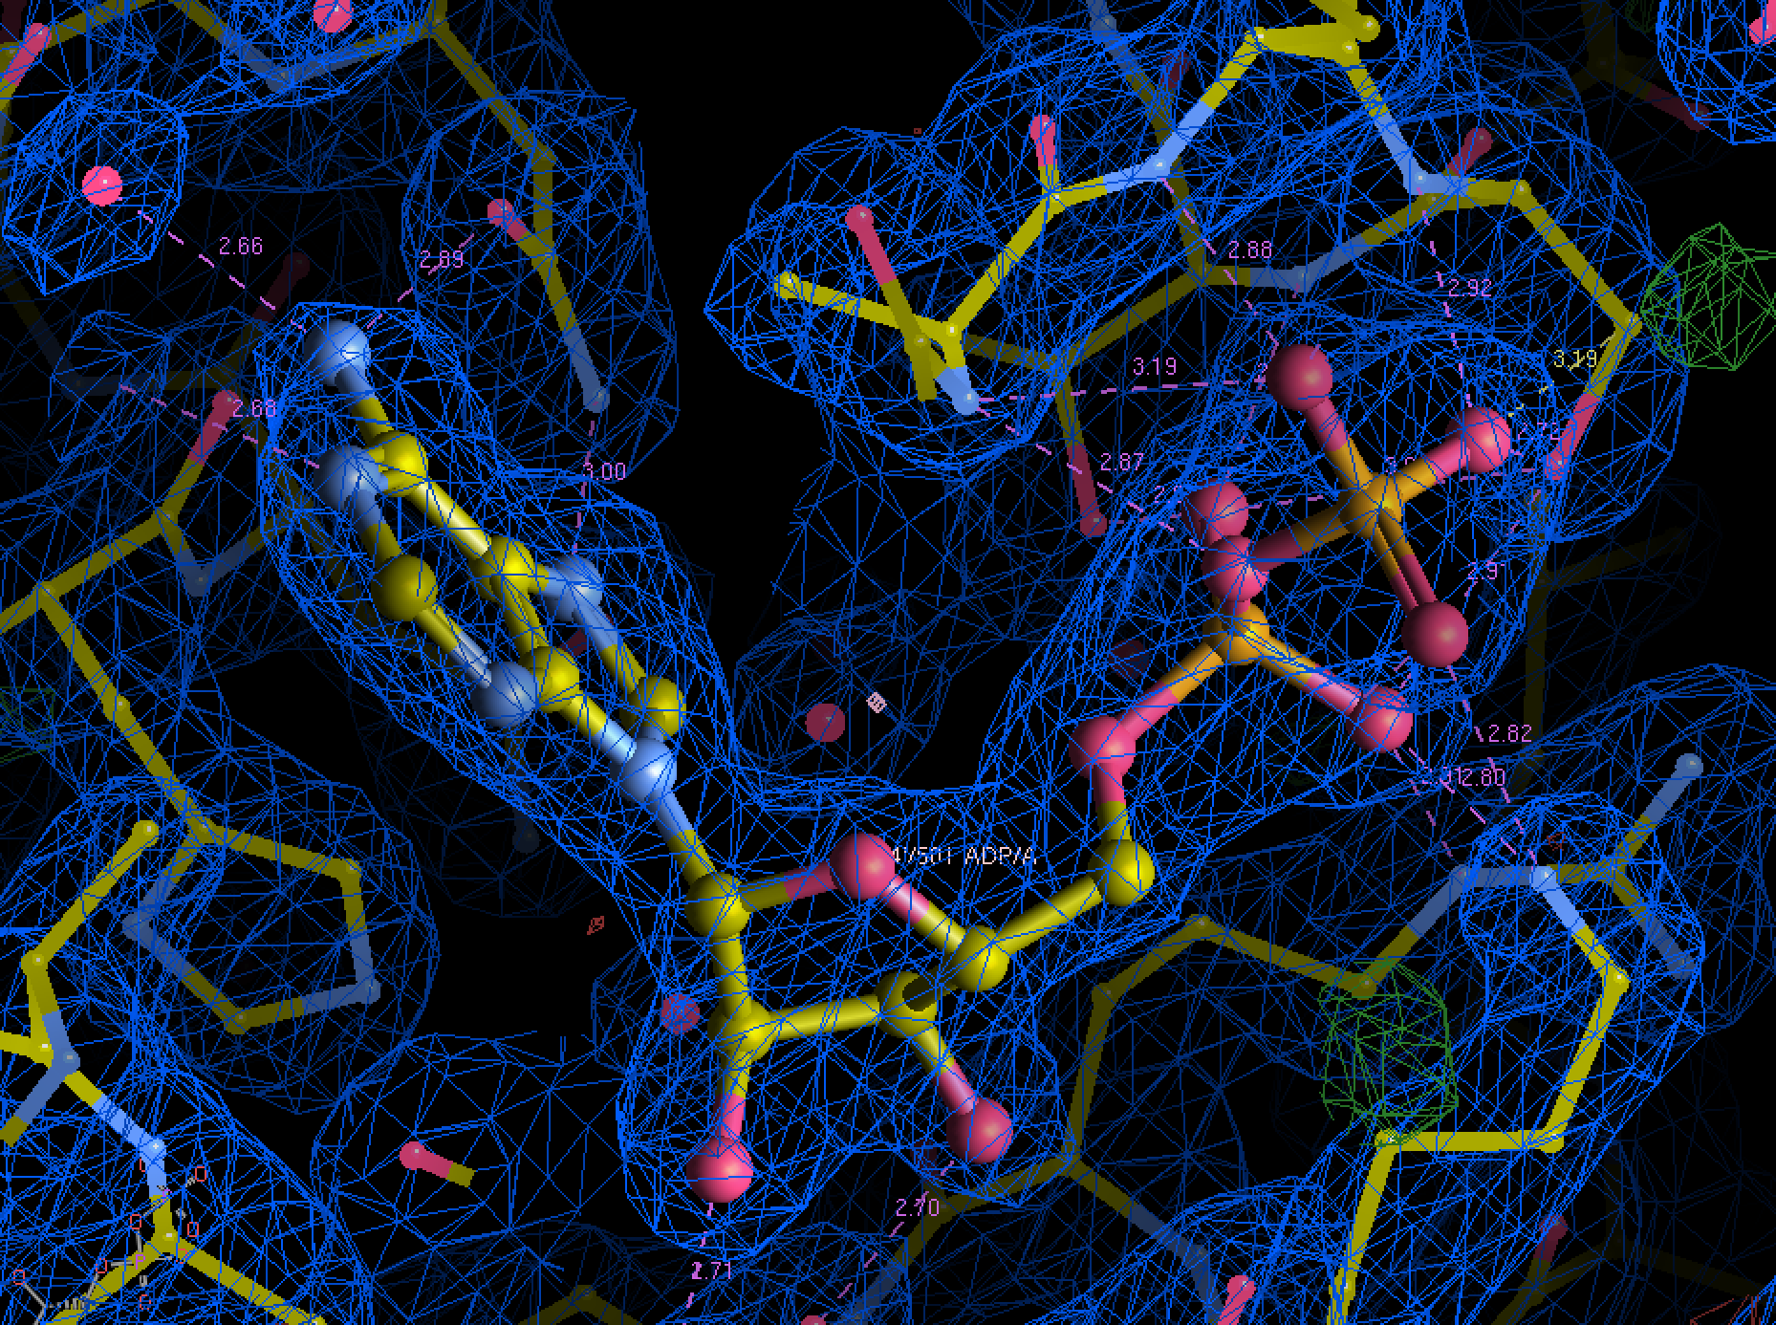
P. aeruginosa, MurD + ADP, PsaeA.17938.a.B2
Status:
noisy diffraction, still OK-ish 2.15Å data set
structure solves and refines well, ADP density clear
working on optimized crystals
P. aerug. MurD + ADP
P. aerug. MurD, apo
A. baum. MurD + ADP
PsaeA.17938.a.B2 + ADP:
Rw=0.202, Rf=0.246
convincing ADP density

Slide 4
Reagents in Bainbridge Island - Proteins
MurC:
P. aeruinosa, MurC
PsaeA.00137.b.B5.PW37941, 22.5mg/ml, 2x 200ul
A. baumanii, MurC
AcbaC.00137.b.B5.PD00479, 20mg/ml, 18x 200ul
MurD
P. aeruinosa, MurC
PsaeA.17938.a.B2.PS38064, 46.5mg/ml, 0x 200ul
PsaeA.17938.a.B2.PS38065, 40mg/ml, 3x 200ul
A. baumanii, MurC
AcbaC.17938.a.B2.PW37960, 43mg/ml, 1x 200ul
AcbaC.17938.a.B1.PS002380, 67mg/ml, 1x 110ul

